Slide 1
Test Maturity Model (TMM)
Group Members:
1.Muhammad Taimoor Aslam(SP21127)
2.Umer Muhammad(SP21132)
3.Mudabbir Altaf(SP21095)

Slide 2
Agenda
Introduction to TMM
TMM Levels
TMM vs. CMMI
Benefits of Implementing TMM
TMM in Practice
Conclusion

Slide 3
Introduction to TMM
Definition: The Test Maturity Model (TMM) is a framework that helps organizations assess and improve their software testing processes.
Purpose: Enhancing the maturity of testing practices to achieve better software quality and reliability.

Slide 4
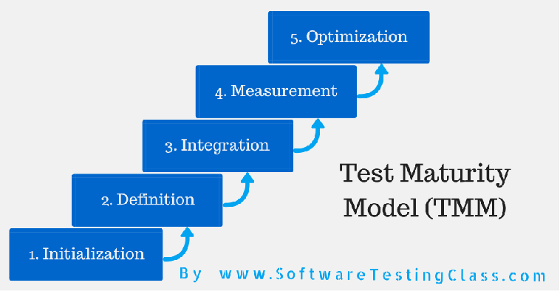
TMM Levels

Slide 5
Level 1 - Initial:
Ad-hoc testing processes.
Lack of standardization.
The objective of testing is to show the software works.
No maturity goals at this level.

Slide 6
Level 2 - Phase Definition
At level 2 of the TMM an organization has defined a testing phase in the software life cycle that follows coding.
Maturity goals at level 2 are:
Develop Testing and Debugging Goals
Develop a Test Planning Process
Institutionalize Basic Testing Techniques and Methods

Slide 7
Level 3 - Integration
This is a critical maturity level and essential for building quality into software products early in the software life cycle.
Maturity goals at level 3 are:
Establish a Software Test Organization
Controlling and Monitoring the Testing Process

Slide 8
Level 4 - Management and Measurement
The principal focus at level 4 of the TMM is on broadening the definition of what is a testing activity, and measurement of the testing process.
Maturity goals for level 4 are:
Establish a Technical Training Program.
Establish a Test Measurement Program
Software Qualify Evaluation

Slide 9
Level 5 - Optimization
At this level we test to insure the software satisfies its specification, that it is reliable and that we can establish a certain level of confidence in its reliability.
Maturity goals at level 5 are:
Quality Control
Continuous process improvement

Slide 10
TMM vs. CMMI
TMM:
Focused on evaluating and improving software testing processes.
Specific to the testing domain within software development.
CMMI:
Encompasses broader organizational processes, including development, service delivery, and acquisition.
Addresses multiple disciplines beyond testing.

Slide 11
Benefits of Implementing TMM
Improved Quality: Higher quality software due to mature testing processes.
Cost Savings: Reduced costs through efficient testing practices.
Enhanced Productivity: Streamlined processes lead to increased productivity.
Predictability: Better predictability of testing outcomes.
Stakeholder Confidence: Increased confidence among stakeholders.

Slide 12
Challenges in TMM Implementation:
Resistance to Change: Organizations may encounter resistance from teams accustomed to ad-hoc processes, requiring effective change management strategies.
Resource Constraints: Optimizing resource utilization at higher maturity levels may pose challenges, particularly in organizations with limited resources.
Measurement Resistance: Overcoming resistance to measurement and analysis is crucial for successful TMM implementation.

Slide 13
Conclusion:
Implementing TMM is a strategic imperative for organizations, ensuring improved software quality, cost efficiency, and stakeholder confidence.
Overcoming challenges through effective change management and continuous improvement is key to sustained testing maturity.
Embrace TMM to elevate testing processes and deliver reliable, high-quality software.

Slide 14
Any Question???

